Slide 1
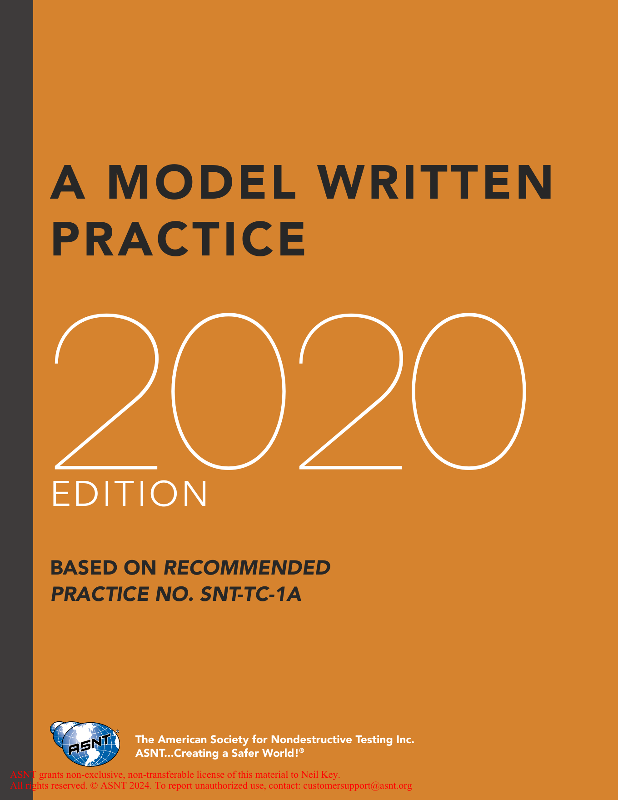
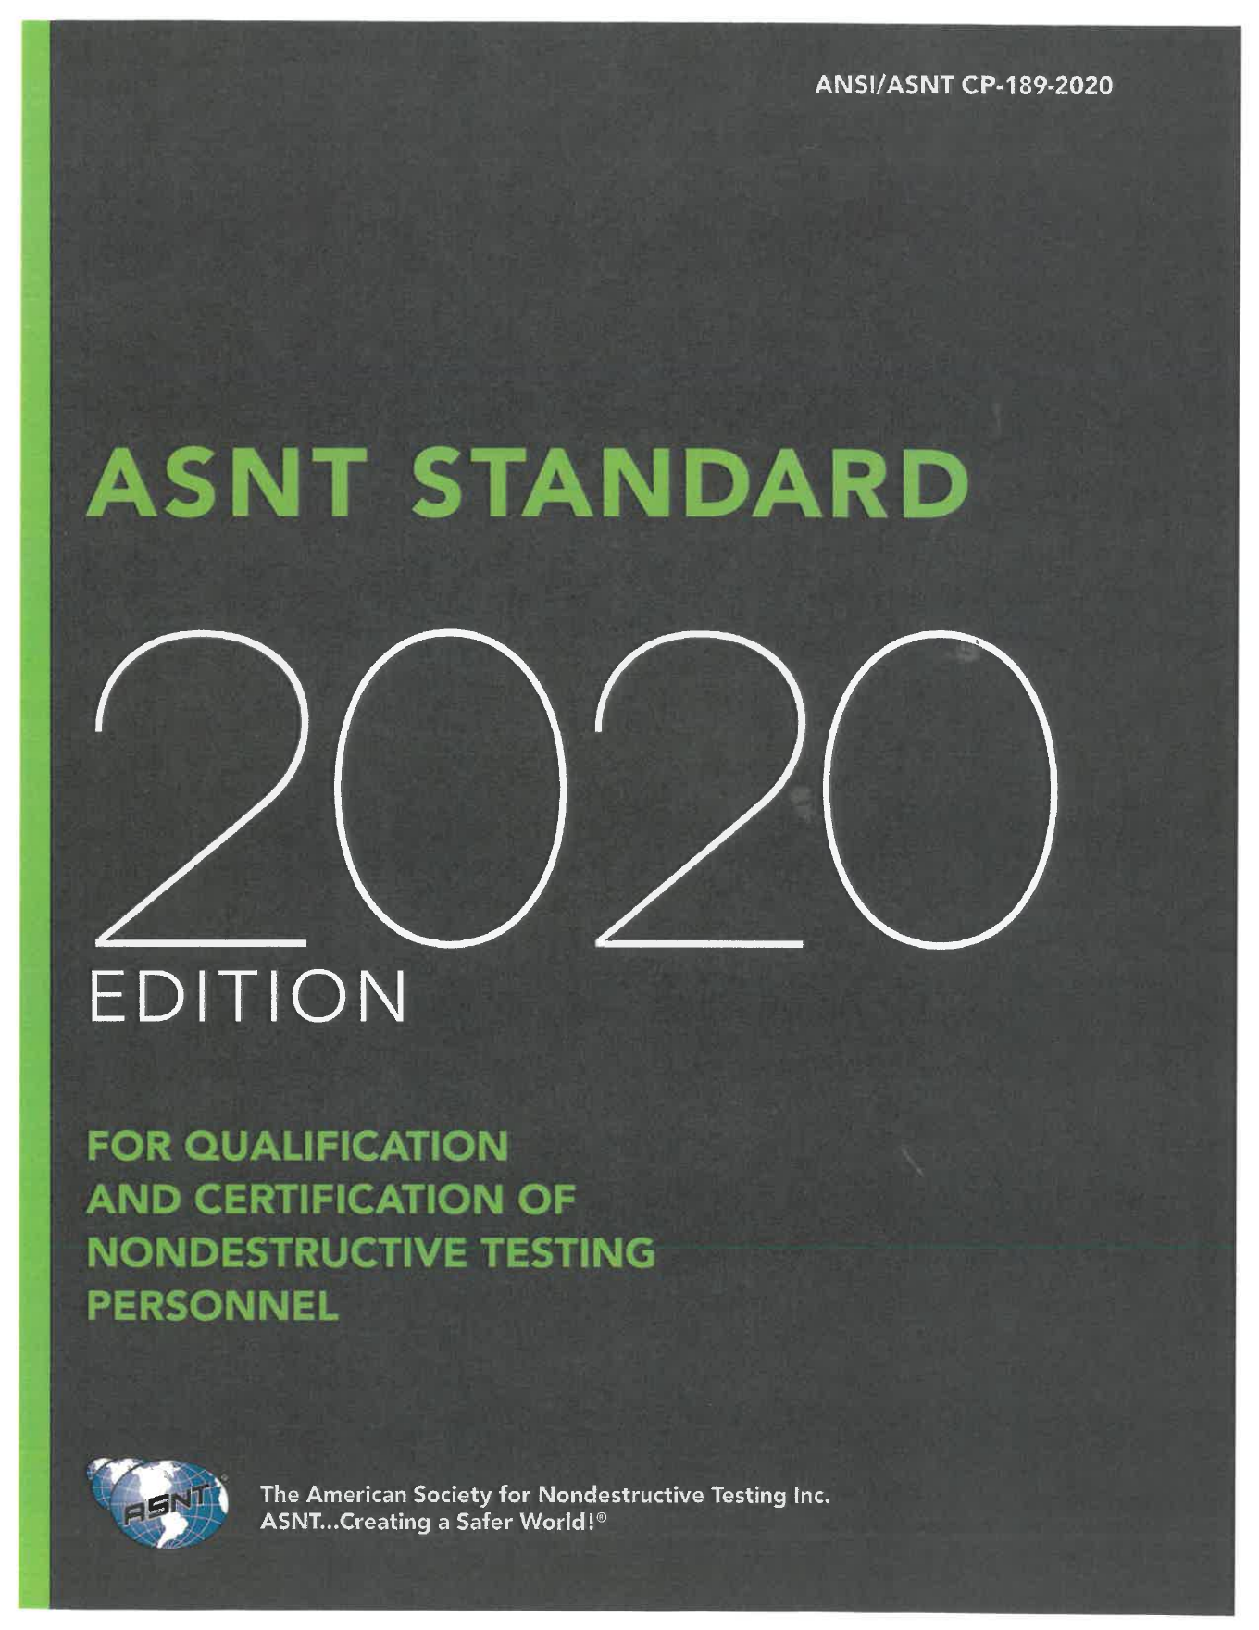
NDT PERSONNEL QUALIFICATION TRAINING
SNT-TC-1A
vs CP-189
Side-by-side teaching comparison using the provided 2020 PDFs
Built as a study deck: clause anchors, short source snippets, practical differences, and audit takeaways.
Comparison Lens
What each line requires, who owns it, what evidence proves it, and where the documents diverge.
Sources: ASNT CP-189-2020 PDF and ASNT Model Written Practice based on SNT-TC-1A (2020)
01

Slide 2
ORIENTATION
Two Documents, One Qualification Goal
They both support NDT personnel qualification, but they behave differently in a program.
SNT-TC-1A model written practice
CP-189
- Employer-facing template language
- Placeholders for company decisions
- Built around a written practice
- Allows justified modifications when documented
- ANSI/ASNT national standard
- Minimum mandatory requirements
- Built around a certification procedure
- Less room to modify without meeting the stated requirement
READ IT
Ask three questions for each clause: What is required? Who approves it? What record proves it?
Sources: ASNT CP-189-2020 PDF and ASNT Model Written Practice based on SNT-TC-1A (2020)
02

Slide 3
CROSSWALK
Section-by-Section Map
CP-189 compresses several controls into fewer sections; the TC-1A model separates them into employer-editable sections.
Topic
CP-189 anchor
TC-1A model anchor
Teaching point
Scope
1.0
1.0
CP states a standard; TC states an employer written practice.
Definitions
2.0
3.0
Mostly shared vocabulary; CP adds PdM and certification procedure framing.
Levels
3.0
5.0
CP defines six levels; TC model presents three basic levels plus trainee.
Training / exp.
4.0 + App. A/B
6.0 + 7.0
CP uses required minimums; TC model points to tables and rationale.
Exams
6.0
8.0
Both use general, specific, practical exams; scoring language differs.
Certification
5.0
9.0
CP requires a procedure; TC model records certification responsibility.
Inactive service
7.0
11.0, 13.0, 14.0
CP gives fixed triggers; TC inserts employer periods.
Recertification
8.0
12.0
CP has 5-year and 10-year controls; TC gives criteria and period.
Records / forms
9.0 + App. C/D
9.0 + sample forms
CP has more certificate/wallet card details.
Sources: ASNT CP-189-2020 PDF and ASNT Model Written Practice based on SNT-TC-1A (2020)
03

Slide 4
BIG IDEA
Guidance Language vs Standard Language
The most important difference is not wording style. It is audit force.
CP-189
SNT-TC-1A model WP
Line-by-line difference
Repeated control word: shall.
CP-189 uses direct minimum requirements and expects the employer certification procedure to satisfy the standard.
Repeated model pattern: [INSERT COMPANY NAME], notes, advisory notes.
The model helps an employer build a written practice around SNT-TC-1A.
When CP-189 is invoked, the question is: did the employer meet the minimum?
When TC-1A is invoked, the question is: did the written practice define and justify the program?
TEACH
Students should learn to mark each clause as requirement, employer choice, or evidence record.
Sources: ASNT CP-189-2020 PDF and ASNT Model Written Practice based on SNT-TC-1A (2020)
04

Slide 5
SCOPE
Scope Line 1: What Each Document Controls
Start with the first requirement line. It tells you what the document is trying to control.
CP-189
SNT-TC-1A model WP
Line-by-line difference
CP 1.1: establishes minimum requirements for qualification and certification of NDT and PdM personnel.
CP 1.2: details minimum training, education, experience, documentation, and certification criteria.
TC model 1.1: establishes minimum requirements for education, training, experience, examination, and certification while employed by the company.
TC 1.2 ties methods to applicable codes, standards, specifications, and procedures.
CP names the standard's minimum floor.
TC names the employer's written practice and leaves company-specific blanks.
CP explicitly includes PdM in scope language.
TEACH
Translate scope into ownership: CP asks whether the program meets a standard; TC asks whether the employer's written practice is complete.
Sources: ASNT CP-189-2020 PDF and ASNT Model Written Practice based on SNT-TC-1A (2020)
05

Slide 6
SCOPE
Scope Line 2: Procedure, Written Practice, and Deviations
Both require employer control, but they handle customization differently.
CP-189
SNT-TC-1A model WP
Line-by-line difference
CP 1.3: employer establishes a certification procedure.
CP 1.4: unique or additional requirements must be incorporated in that procedure.
CP 1.5 allows qualifying central certifications when conditions are met.
TC model 1.3: an annex identifies deviations from SNT-TC-1A.
Notes instruct the employer to document rationale when modifying detailed recommendations.
CP customization goes into the certification procedure while still satisfying CP-189.
TC customization is expected, but the employer should document what changed and why.
TEACH
If a practice deviates, make the student find the rationale and the approval signature.
Sources: ASNT CP-189-2020 PDF and ASNT Model Written Practice based on SNT-TC-1A (2020)
06

Slide 7
DEFINITIONS
Definitions: Similar Words, Different Program Weight
Definitions are not filler. They decide what records, roles, and limits mean.
CP-189
SNT-TC-1A model WP
Line-by-line difference
CP 2.1 defines terms for this standard only.
Adds Certification Procedure, Education, Examination, Formal Training, NDT Instructor, Outside Organization, PdM, and Specific Examination.
TC model 3.0 lists employer-ready definitions.
Includes Certifying Agency, Comparable, Detection Rate, False Call, Limited Certification, Recommended Practice, and Third-Party Agency.
CP vocabulary is built for mandatory certification control.
TC vocabulary is built for drafting an employer written practice.
Some terms overlap but point to different document structures.
TEACH
Teach students to compare definitions before comparing requirements; the same word can carry different program consequences.
Sources: ASNT CP-189-2020 PDF and ASNT Model Written Practice based on SNT-TC-1A (2020)
07

Slide 8
LEVELS
Levels of Qualification
Both describe Level I, II, and III, but CP-189 defines a broader qualification ladder.
CP-189
SNT-TC-1A model WP
Line-by-line difference
CP 3.1 defines six levels.
CP 3.2-3.7: NDT Level III, Level II, Level II Limited, Level I, Trainee, and NDT Instructor.
Instructor is a defined qualification role.
TC model 5.1 says three basic levels.
TC 5.2 defines trainee behavior.
TC 5.3 defines Level I, Level II, and Level III responsibilities.
CP pulls Level II Limited and NDT Instructor into the level structure.
TC treats limited certification and instructor/training controls in other clauses and notes.
TEACH
A CP-189 procedure should not hide instructor or Level II Limited controls in vague language.
Sources: ASNT CP-189-2020 PDF and ASNT Model Written Practice based on SNT-TC-1A (2020)
08

Slide 9
METHODS
Methods and Techniques
This is where the program turns from policy into job scope.
CP-189
SNT-TC-1A model WP
Line-by-line difference
CP Appendix A/B list methods and limited techniques with required training and experience hours.
CP 6.3.3 links practical demonstration to the techniques in Appendix A.
TC model 4.1 tells the employer to list applicable methods and techniques.
TC 6.3 and tables are used to select training and experience hours.
CP supplies a prescriptive table set.
TC model prompts the employer to fill the method list and adapt tables when justified.
TEACH
For audits, compare the employee certificate, the method/technique list, and the practical exam scope.
Sources: ASNT CP-189-2020 PDF and ASNT Model Written Practice based on SNT-TC-1A (2020)
09

Slide 10
QUALIFICATION
Training and Experience Requirements
Both documents care about training hours and experience, but CP-189 is tighter.
CP-189
SNT-TC-1A model WP
Line-by-line difference
CP 4.1: Level I/II candidates shall complete organized training.
CP 4.1.1 points to Appendices A/B minimum hours.
CP 4.2 requires practical experience by level.
TC model 6.1 requires sufficient education, training, and experience.
TC 6.3 points to tables.
TC advisory notes allow modified hours for limited applications with rationale.
CP says minimum hours are required.
TC model tells the employer how to document and justify the selected requirements.
TEACH
The difference to teach: CP minimums are a floor; TC model choices need traceability.
Sources: ASNT CP-189-2020 PDF and ASNT Model Written Practice based on SNT-TC-1A (2020)
10

Slide 11
TRAINING
Training Programs and Instructor Control
The training clause answers: who designed it, who approved it, and how do you prove completion?
CP-189
SNT-TC-1A model WP
Line-by-line difference
CP 4.1 requires a Level III-approved course outline.
CP 4.4 sets NDT Instructor criteria and requires designation by an NDT Level III.
Training credit requires passing a final exam.
TC model 7.1 allows instructor-led, personalized, virtual, computer-based, or web-based training.
All training programs are approved by the responsible NDT Level III.
CP defines who may be an instructor.
TC model focuses on the employer's approved training program and purchased training services.
TEACH
Ask for the course outline, approval, instructor designation, attendance/hours, and training exam result.
Sources: ASNT CP-189-2020 PDF and ASNT Model Written Practice based on SNT-TC-1A (2020)
11

Slide 12
EXAMS
Vision Examination
Vision looks small on paper, but it often controls whether certification is active today.
CP-189
SNT-TC-1A model WP
Line-by-line difference
CP 6.1.1 requires near-distance acuity equivalent to Jaeger J-1.
CP 6.1.3: vision annually; color differentiation at each recertification.
CP 6.1.4: approved procedure/personnel.
TC model 8.2.1 uses Jaeger Number 2 or equivalent unless the employer inserts another test.
TC 8.2.2: color contrast at initial certification and five-year intervals.
CP is stricter on near vision in the provided text.
TC model gives employer insert points and a different color interval in the model wording.
TEACH
For CP-189 work, do not assume a TC-1A vision line is automatically strict enough.
Sources: ASNT CP-189-2020 PDF and ASNT Model Written Practice based on SNT-TC-1A (2020)
12

Slide 13
EXAMS
Written Exams: General and Specific
General tests method knowledge; specific tests employer work.
CP-189
SNT-TC-1A model WP
Line-by-line difference
CP 6.3.1: general exam is closed book and based on CP-105 body of knowledge.
CP 6.3.2: specific exam addresses employer equipment, procedures, and techniques.
Table 1 gives minimum question counts.
TC model 8.3: general exams address basic principles.
TC 8.4: specific exams address company equipment, procedures, codes, and acceptance criteria.
Table 3 is filled from SNT-TC-1A.
Both use general and specific exams.
CP embeds a fixed question table.
TC model warns ASNT Q&A examples should not be used verbatim.
TEACH
A good comparison asks whether the question bank matches the work actually being certified.
Sources: ASNT CP-189-2020 PDF and ASNT Model Written Practice based on SNT-TC-1A (2020)
13

Slide 14
EXAMS
Practical Exams and Passing Scores
This is the line-by-line comparison most trainees remember, because it affects pass/fail.
CP-189
SNT-TC-1A model WP
Line-by-line difference
CP 6.4.2: written exams at least 70%, practical at least 80%, composite average 80%.
CP practicals require specified discontinuities/conditions and written checklists.
TC model 8.1.5: composite at least 80%, no written exam less than 70%, practical should be at least 80%.
TC 8.5 adds 10 checkpoints and detection/false-call controls.
CP uses mandatory scoring language for practicals.
TC model uses should for the practical score in the provided model wording, while still building a robust practical format.
TEACH
Teach the difference between a hard minimum and a model recommendation, then check the governing contract.
Sources: ASNT CP-189-2020 PDF and ASNT Model Written Practice based on SNT-TC-1A (2020)
14

Slide 15
LEVEL III
NDT Level III Qualification Path
Level III is the program's technical control point in both documents.
CP-189
SNT-TC-1A model WP
Line-by-line difference
CP 6.2.1: before employer certification exams, the candidate holds a current ASNT Level III certificate for each method.
CP 6.2.2 requires at least 30 employer-specific questions.
TC model 8.7 requires Level III basic, method, and specific exams unless valid ASNT/ACCP endorsements satisfy listed criteria.
TC 8.7.3 allows deletion of specific under stated conditions.
CP starts from current ASNT Level III certification as an initial requirement.
TC model gives a broader exam framework with certificate substitutions.
TEACH
When comparing Level III files, look for both the external certificate and employer-specific evidence.
Sources: ASNT CP-189-2020 PDF and ASNT Model Written Practice based on SNT-TC-1A (2020)
15

Slide 16
PROGRAM CONTROL
Certification Procedure vs Written Practice
Both documents require written control, but the controlled document is framed differently.
CP-189
SNT-TC-1A model WP
Line-by-line difference
CP 5.1: employer shall develop and maintain a certification procedure.
CP 5.2 lists required contents: duties, training, experience, exams, records, documentation, and recertification.
CP 5.3 requires Level III approval.
TC model is itself a written-practice template.
It repeatedly asks the employer to insert names, roles, records, tables, periods, and forms.
CP asks: does the employer procedure satisfy every CP-189 requirement?
TC asks: did the employer make a complete written practice and follow it?
TEACH
Have students highlight every blank or bracketed insertion before calling a TC-1A written practice complete.
Sources: ASNT CP-189-2020 PDF and ASNT Model Written Practice based on SNT-TC-1A (2020)
16

Slide 17
RECORDS
Records and Certificates
Records are the evidence trail. CP-189 is more explicit about certificate and wallet-card details.
CP-189
SNT-TC-1A model WP
Line-by-line difference
CP 9.2 requires training, certification, experience, previous experience, current examinations, and vision records.
CP 9.2.6 adds certificate/wallet card rules, ASNT Policy G-14, legal name, edition year, limitations, and signatures.
TC model 9.4 lists certified individuals, level/method/limitations, education, training, vision, exams, grades, Level III verification, dates, expiration, and certifying authority signature.
TC 9.5 addresses active files and certificates/cards.
Both require traceable personnel records.
CP is more detailed about the format and wording of certificates/cards when issued.
TEACH
A clean file should let an auditor reconstruct how the person was qualified, certified, recertified, suspended, or reinstated.
Sources: ASNT CP-189-2020 PDF and ASNT Model Written Practice based on SNT-TC-1A (2020)
17

Slide 18
STATUS
Expiration, Suspension, Revocation, and Reinstatement
CP-189 gives fixed triggers; the TC model leaves more timing to employer selection.
CP-189
SNT-TC-1A model WP
Line-by-line difference
CP 7.1: Level I/II expire at five years; Level III expires when ASNT Level III expires.
CP 7.2: suspend after 12 months without duties.
CP 7.3: revoke after 24 months without duties or unethical/incompetent conduct.
TC model 11: interrupted service periods are inserted by the employer.
TC 13: termination revokes certification.
TC 14: reinstatement without new exam if records are maintained, certification did not expire, and reinstatement is within six months.
CP fixes inactivity and expiration triggers.
TC model requires the employer to define reasonable periods and conditions.
TEACH
Train students to separate expiration, suspension, revocation, termination, and reinstatement; they are not interchangeable.
Sources: ASNT CP-189-2020 PDF and ASNT Model Written Practice based on SNT-TC-1A (2020)
18

Slide 19
RECERTIFICATION
Recertification
Recertification is where ongoing performance becomes evidence.
CP-189
SNT-TC-1A model WP
Line-by-line difference
CP 8.1: Level I/II recertified by reexamination or 350 hours documented experience plus a specific exam every five years.
CP 8.1.2: repeat Section 6 exams at least every 10 years.
CP 8.2: Level III every five years by current ASNT certificate.
TC model 12.1: recertify by continuing satisfactory technical performance or reexamination.
TC 12.2: every five years, or less if the employer inserts a shorter period.
TC 12.3 addresses new techniques for Level III.
CP provides a more explicit 5-year/10-year path.
TC model is more flexible but still requires a defined period and evidence.
TEACH
For a comparison exercise, make students build the timeline from initial cert date to expiration to recert evidence.
Sources: ASNT CP-189-2020 PDF and ASNT Model Written Practice based on SNT-TC-1A (2020)
19

Slide 20
APPENDIXES
Appendixes, Tables, and Forms
The appendixes show how each document expects the employer to operationalize the rules.
CP-189
SNT-TC-1A model WP
Line-by-line difference
CP Appendixes A/B supply initial training and experience requirements.
CP Appendixes C/D provide sample certification forms/certificates.
Appendix E gives interpretation policy.
TC model includes sample forms tied to the written practice.
Tables and forms are intended to be filled or adapted by the employer.
CP A/B tables function as required minimum program content.
TC forms are implementation tools and must match the employer's final written practice.
TEACH
A form that does not match the governing written practice or certification procedure becomes audit risk.
Sources: ASNT CP-189-2020 PDF and ASNT Model Written Practice based on SNT-TC-1A (2020)
20

Slide 21
AUDIT PATH
Clause-by-Clause Audit Path
Use this as a teaching drill: pick a person, pick a method, and trace the evidence.
Program question
CP-189 proof
TC model proof
What to teach
Who owns the program?
Certification procedure
Written practice
Find approval authority.
What method/technique?
Appendix A/B plus certificate
Section 4 plus tables
Match scope to job.
Training met?
Minimum hours and exam
Table/rationale and record
Hours alone are not enough.
Experience met?
Documented method hours
Documented comparable work
Supervisor/Level III review.
Exams passed?
70 written, 80 practical, 80 composite
80 composite, written no less than 70
Check score logic.
Vision current?
Annual near vision
Model annual near vision
Check test type and expiry.
Cert issued?
Required record fields
Required record fields
Verify signatures and dates.
Inactive?
12-month suspension / 24-month revocation
Employer inserted periods
Do not blend status terms.
Recert due?
5-year cycle, 10-year full repeat
5-year or shorter employer period
Build the timeline.
Sources: ASNT CP-189-2020 PDF and ASNT Model Written Practice based on SNT-TC-1A (2020)
21

Slide 22
TEACHING CLOSE
What Learners Should Remember
A practical way to compare the standards without getting lost in wording.
1
CP-189 is the stricter comparison baseline when it is contractually invoked.
2
The TC-1A model written practice is a drafting tool; the employer must complete and own it.
3
Training, experience, exams, vision, records, and recertification must all connect to the certified method and technique.
4
Short wording differences can change audit evidence: shall vs should, fixed period vs employer insert, minimum table vs justified modification.
DRILL
For any clause: read the source line, name the program action, then name the record that proves it.
Sources: ASNT CP-189-2020 PDF and ASNT Model Written Practice based on SNT-TC-1A (2020)
22

